Slide 1
CST2335 Graphical Interface programming
Extra material
NavigationDrawer (Sliding Menu)

Slide 2
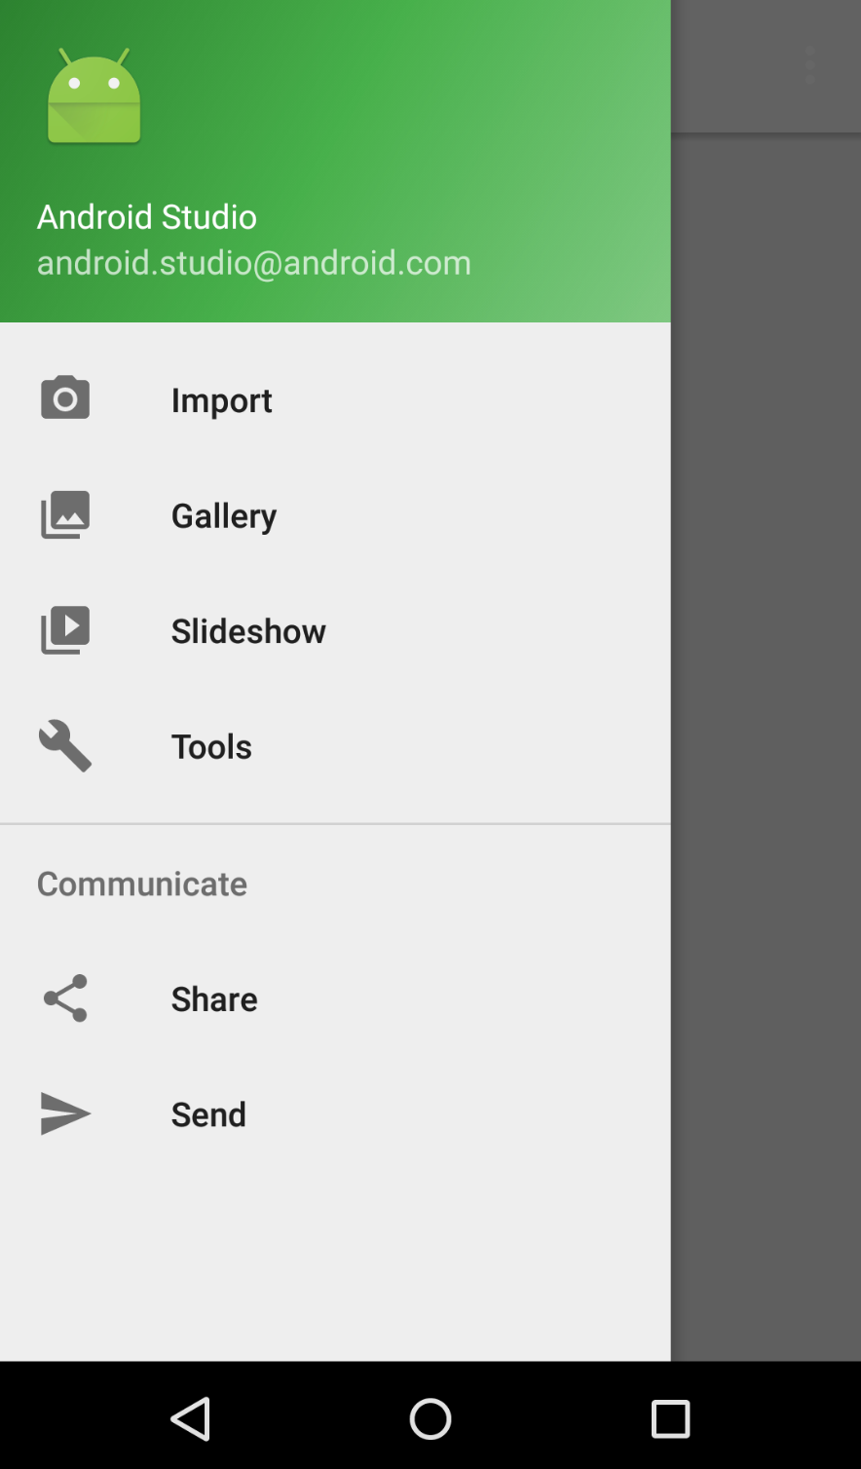
Introduction
This week, you will learn how create a NavigationDrawer and add menu items for selection.
This needs Android version 22 or newer.

Slide 3
Add Libraries
Create a new AppCompatActivity, not Activity!!
Your new AppCompatActivity must implement the interface: NavigationView.OnNavigationItemSelectedListener
NavigationView is part of com.google.android.material.navigation.NavigationView;
Look at NavigationExample.java. It uses the layout R.layout.activity_navigation_example

Slide 4
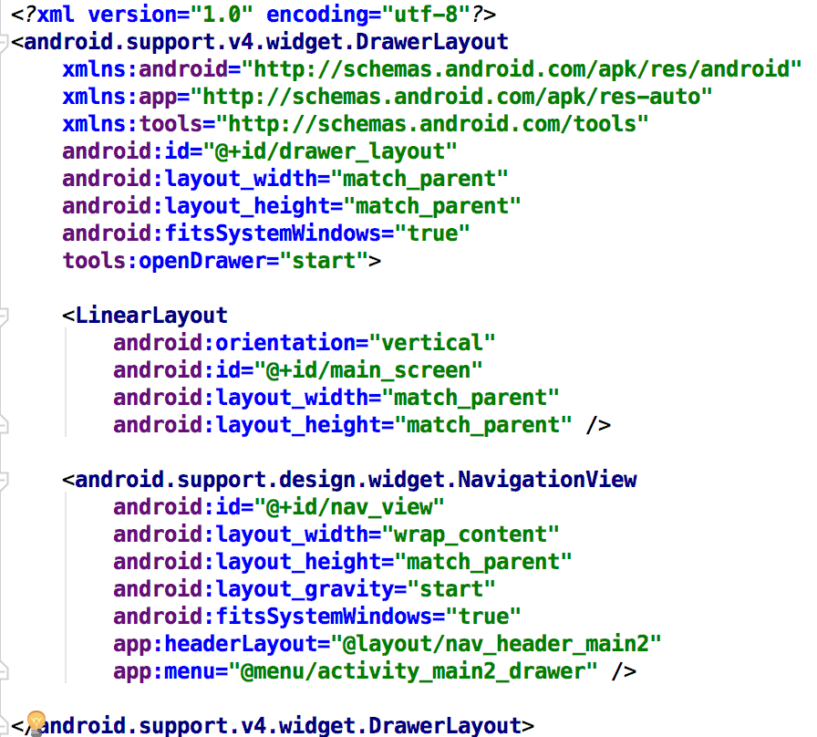
DrawerLayout
A DrawerLayout takes two sub-items. The first is the main screen, the second is the layout for the NavigationView (Sliding Menu).

Slide 5
NavigationView
NavigationViews have a Header, and a Menu.
The Header is pictures/explanation.
The Menu are selectable MenuItems

Slide 6
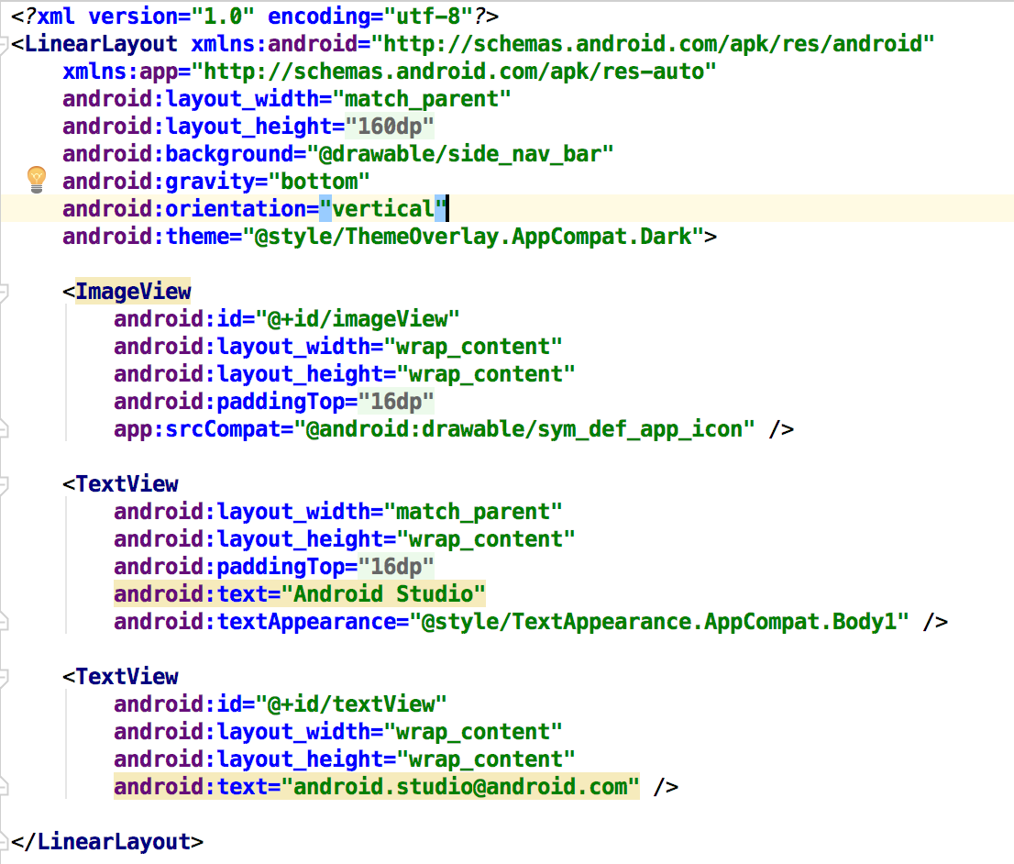

Header
The header can be any layout (LinearLayout, RelativeLayout), containing Text, Images, etc.

Slide 7
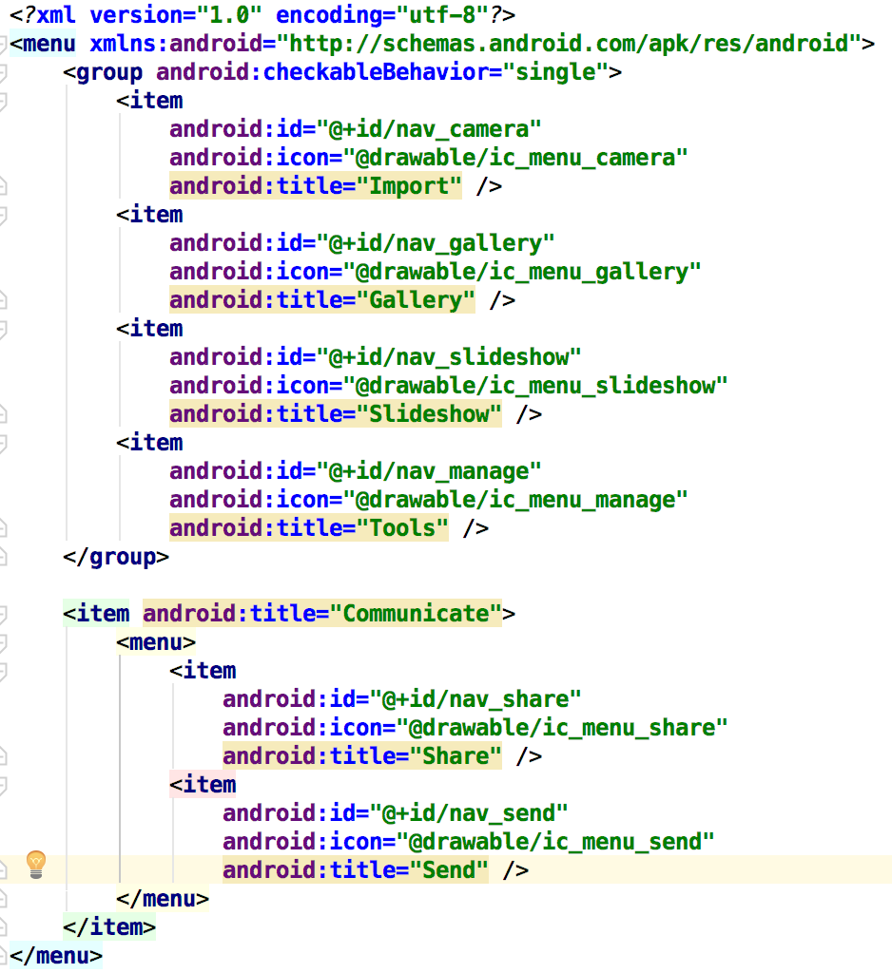
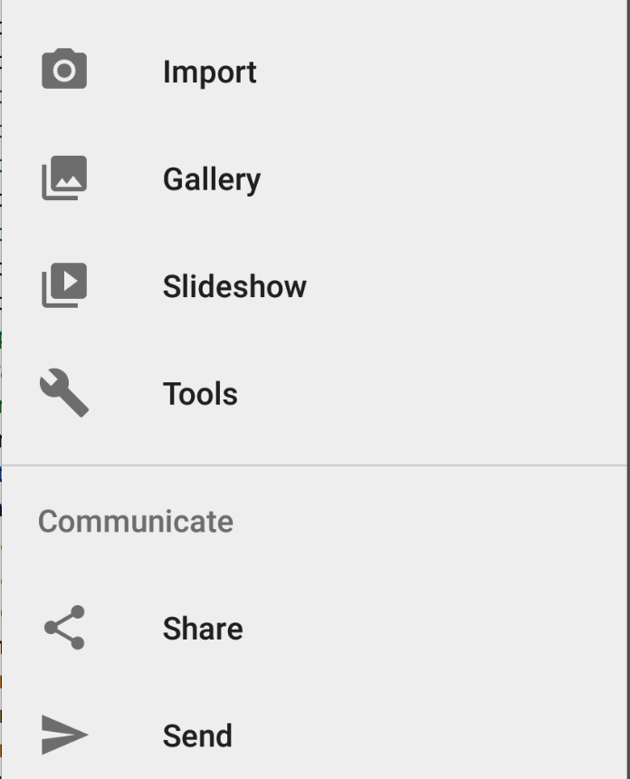
Menu
The selectable menu items are just like the Toolbar:

Slide 8
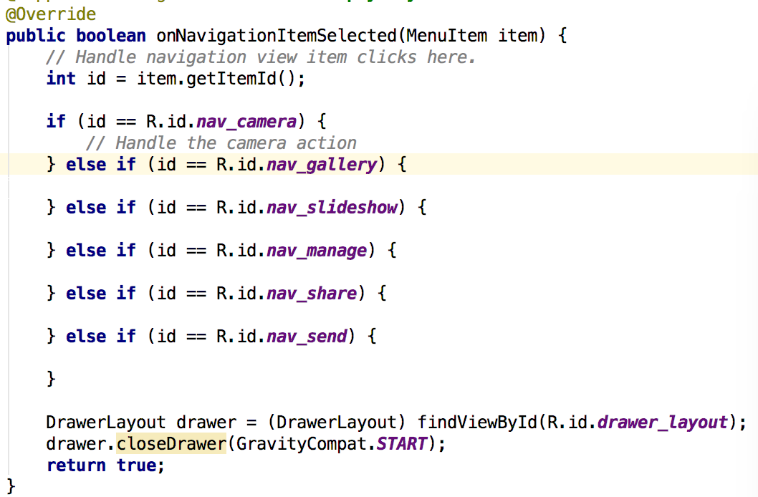
Activity functions
boolean onNavigationItemSelected(MenuItem item) - This function responds to anNavigationItem selection:
Add cases for each ID of items
from your XML menu
Close the drawer

Slide 9
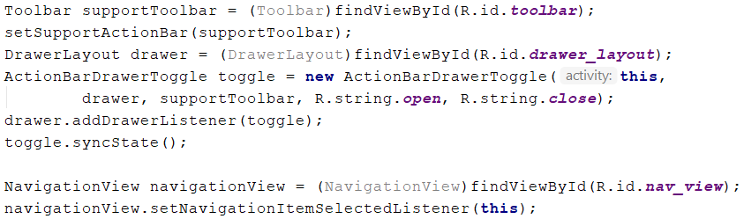
ToolBar integration
You need a Toolbar on your display to show the Drawer toggle button. In your onCreate function, add this code:
This code registers for NavigationItem Selection events

Slide 10
Exercise
Go to the following URL and try the example:
https://guides.codepath.com/android/fragment-navigation-drawer

